Slide 1
Module 2

Slide 2
Cipher Block Modes of Operations

Slide 3
How to use a block cipher?
Block ciphers encrypt fixed-size blocks
e.g. DES encrypts 64-bit blocks
We need some way to encrypt a message of arbitrary length
e.g. a message of 1000 bytes
NIST defines several ways to do it
called modes of operation

Slide 4
Five Modes of Operation
Electronic codebook mode (ECB)
Cipher block chaining mode (CBC) – most popular
Output feedback mode (OFB)
Cipher feedback mode (CFB)
Counter mode (CTR)

Slide 5
Electronic Code Book (ECB)
The plaintext is broken into blocks, P₁, P₂, P₃, ...
Each block is encrypted independently:
C_{i} = E_{K}(P_{i})
For a given key, this mode behaves like we have a gigantic codebook, in which each plaintext block has an entry, hence the name Electronic Code Book

Slide 6
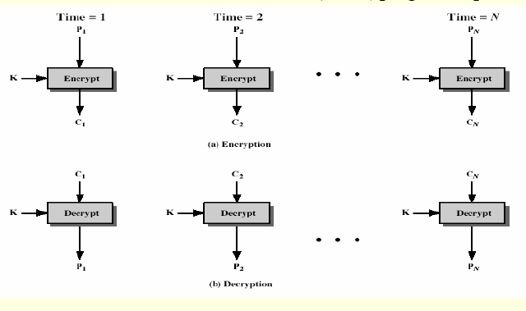

Slide 7
Remarks on ECB
Strength: it’s simple.
Weakness:
Repetitive information contained in the plaintext may show in the cipher text, if aligned with blocks.
If the same message is encrypted (with the same key) and sent twice, their cipher texts are the same.
Typical application: secure transmission of short pieces of information (e.g. a temporary encryption key)

Slide 8
Cipher Block Chaining (CBC)

Slide 9
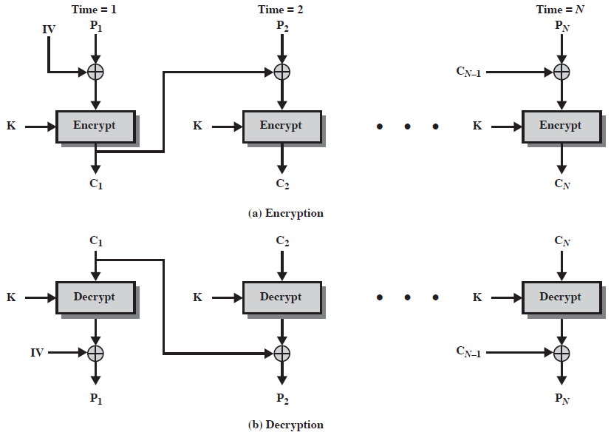
Cipher Block Chaining (CBC)

Slide 10
Remarks on CBC
The encryption of a block depends on the current and all blocks before it.
So, repeated plaintext blocks are encrypted differently.
Initialization Vector (IV)
Must be known to both the sender & receiver
Typically, IV is either a fixed value or is sent encrypted in ECB mode before the rest of ciphertext.

Slide 11
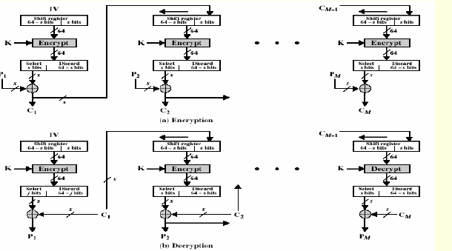
Cipher Feedback (CFB) Mode

Slide 12
Remark on CFB
The block cipher is used as a stream cipher.
Appropriate when data arrives in bits/bytes.
s can be any value; a common value is s = 8.
A ciphertext segment depends on the current and all preceding plaintext segments.
A corrupted ciphertext segment during transmission will affect the current and next several plaintext segments.
How many plaintext segments will be affected?

Slide 13
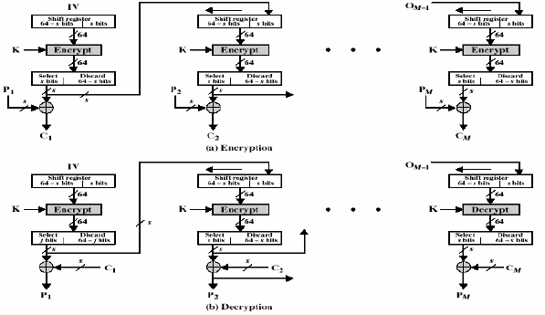
Output Feedback (OFB) Mode

Slide 14
Remark on OFB
The block cipher is used as a stream cipher.
Appropriate when data arrives in bits/bytes.
Advantage:
more resistant to transmission errors; a bit error in a ciphertext segment affects only the decryption of that segment.
Disadvantage:
Cannot recover from lost ciphertext segments; if a ciphertext segment is lost, all following segments will be decrypted incorrectly (if the receiver is not aware of the segment loss).
IV should be generated randomly each time and sent with the ciphertext.

Slide 15
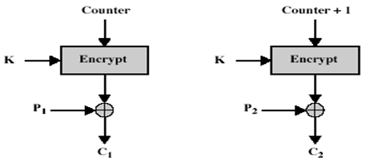
Counter Mode (CTR)
Plaintext blocks: p₁, p₂, p₃, …
Key: k
Encryption:

Slide 16
Remark on CTR
Strengthes:
Needs only the encryption algorithm
Fast encryption/decryption; blocks can be processed (encrypted or decrypted) in parallel; good for high speed links
Random access to encrypted data blocks
IV should not be reused.

